Slide 1
Fundamentals of Data Science
Ch 2: The data science process
First Semester 2022/2023

Slide 2
This chapter covers:
Understanding the flow of a data science process
Discussing the steps in a data science process

Slide 3
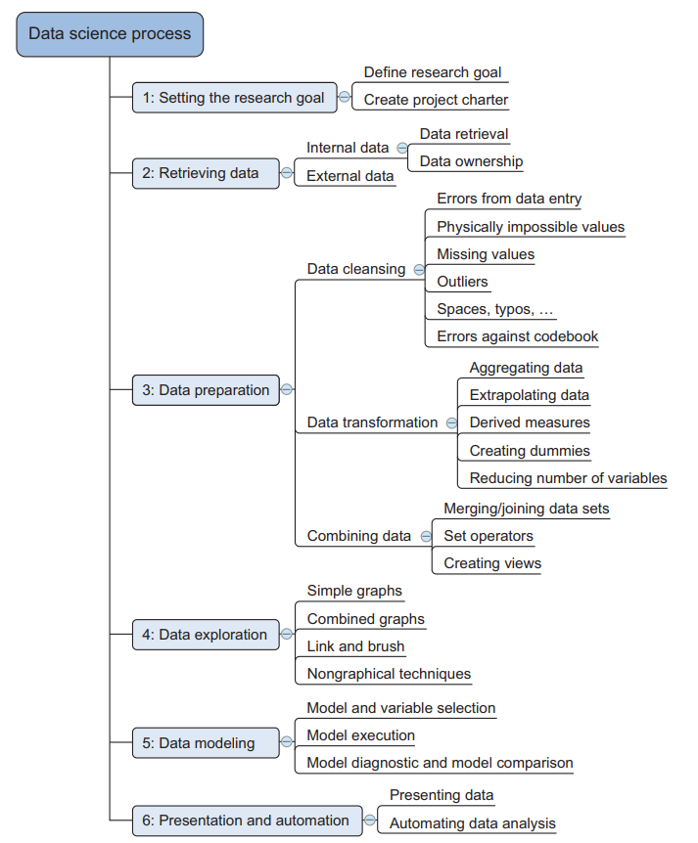
Overview of the data science process
The typical data science process consists
of six steps through which you’ll iterate,
as shown in the figure
This figure summarizes the data science process and shows the main steps and actions you’ll take during a project. The following list is a short introduction; each of the steps will be discussed in greater depth throughout this chapter

Slide 4
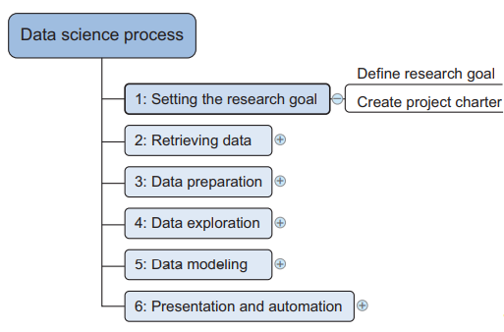
Step 1: Defining research goals and creating a project charter
A project starts by understanding the what, the why, and the how of your project
(figure 2.2). What does the company expect you to do? And why does management
place such a value on your research? Is it part of a bigger strategic picture
or a “lone wolf” project originating from an opportunity someone detected?
Answering these three questions (what, why, how) is the goal
of the first phase, so that everybody knows what to do
and can agree on the best course of action.
The outcome should be a clear research goal,
a good understanding of the context, well-defined deliverables,
and a plan of action with a timetable.
This information is then best placed in a project charter.
The length and formality can, of course, differ between projects and companies.
In this early phase of the project, people skills and business acumen are more important than great technical prowess, which is why this part will often be guided by more senior personnel

Slide 5
Step 1-1: Spend time understanding the goals and context of your research
An essential outcome is the research goal that states the purpose of your assignment in a clear and focused manner. Understanding the business goals and context is critical for project success. Continue asking questions and devising examples until you grasp the exact business expectations, identify how your project fits in the bigger picture, appreciate how your research is going to change the business, and understand how they’ll use your results. Nothing is more frustrating than spending months researching something until you have that one moment of brilliance and solve the problem, but when you report your findings back to the organization, everyone immediately realizes that you misunderstood their question. Don’t skim over this phase lightly. Many data scientists fail here: despite their mathematical wit and scientific brilliance, they never seem to grasp the business goals and context.

Slide 6
Step 1-2: Create a project charter
All this information is best collected in a project charter. For any significant project this would be mandatory.
A project charter requires teamwork, and your input covers at least the following:
A clear research goal
The project mission and context
How you’re going to perform your analysis
What resources you expect to use
Proof that it’s an achievable project, or proof of concepts
Deliverables and a measure of success
A timeline

Slide 7
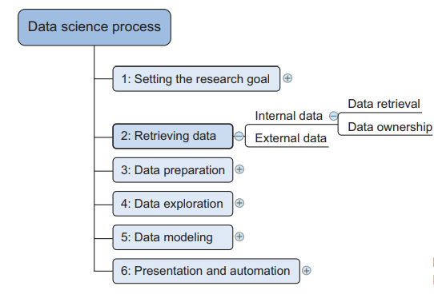
Step 2: Retrieving data
The next step in data science is to retrieve
the required data. Sometimes you need
to go into the field and design a data collection
process yourself, but most of the time you
won’t be involved in this step.
Many companies will have already collected and stored the data for you, and what they don’t have can often be bought from third parties. Don’t be afraid to look outside your organization for data, because more and more organizations are making even high-quality data freely available for public and commercial use. Data can be stored in many forms, ranging from simple text files to tables in a database. The objective now is acquiring all the data you need. This may be difficult, and even if you succeed, data is often like a diamond in the rough: it needs polishing to be of any use to you

Slide 8
2.3.1 Start with data stored within the company
Your first act should be to assess the relevance and quality of the data that’s readily available within your company. Most companies have a program for maintaining key data, so much of the cleaning work may already be done. This data can be stored in official data repositories such as databases, data marts, data warehouses, and data lakes maintained by a team of IT professionals. The primary goal of a database is data storage, while a data warehouse is designed for reading and analyzing that data. A data mart is a subset of the data warehouse and geared toward serving a specific business unit. While data warehouses and data marts are home to preprocessed data, data lakes contains data in its natural or raw format. But the possibility exists that your data still resides in Excel files on the desktop of a domain expert. Finding data even within your own company can sometimes be a challenge. As companies grow, their data becomes scattered around many places. Knowledge of the data may be dispersed as people change positions and leave the company. Documentation and metadata aren’t always the top priority of a delivery manager, so it’s possible you’ll need to develop some Sherlock Holmes–like skills to find all the lost bits.
Getting access to data is another difficult task. Organizations understand the value and sensitivity of data and often have policies in place so everyone has access to what they need and nothing more. These policies translate into physical and digital barriers called Chinese walls. These “walls” are mandatory and well-regulated for customer data in most countries. This is for good reasons, too; imagine everybody in a credit card company having access to your spending habits. Getting access to the data may take time and involve company politics.

Slide 9
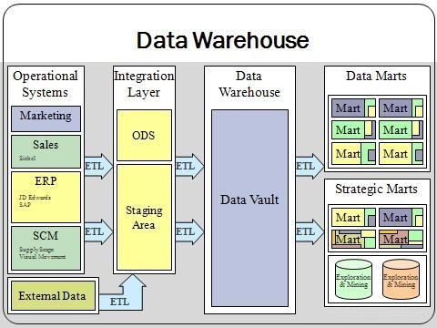

Slide 10
2.3.2 Don’t be afraid to shop around
If data isn’t available inside your organization, look outside your organization’s walls. Many companies specialize in collecting valuable information. For instance, Nielsen and GFK are well known for this in the retail industry. Other companies provide data so that you, in turn, can enrich their services and ecosystem. Such is the case with Twitter, LinkedIn, and Facebook. Although data is considered an asset more valuable than oil by certain companies, more and more governments and organizations share their data for free with the world. This data can be of excellent quality; it depends on the institution that creates and manages it. The information they share covers a broad range of topics such as the number of accidents or amount of drug abuse in a certain region and its demographics. This data is helpful when you want to enrich proprietary data but also convenient when training your data science skills at home. Table 2.1 shows only a small selection from the growing number of open-data providers.

Slide 11
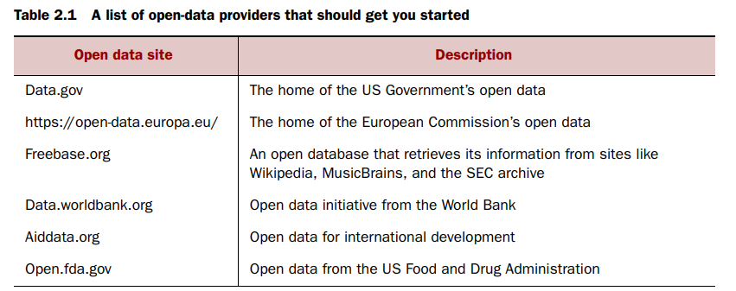

Slide 12
Step 3: Cleansing, integrating, and transforming data
The data received from the data retrieval phase is likely to be “a diamond in the rough.” Your task now is to sanitize and prepare it for use in the modelling and reporting phase. Doing so is tremendously important because your models will perform better and you’ll lose less time trying to fix strange output. It can’t be mentioned nearly enough times: garbage in equals garbage out. Your model needs the data in a specific format, so data transformation will always come into play. It’s a good habit to correct data errors as early on in the process as possible. However, this isn’t always possible in a realistic setting, so you’ll need to take corrective actions in your program. Figure 2.4 shows the most common actions to take during the data cleansing, integration, and transformation phase. This mind map may look a bit abstract for now, but we’ll handle all of these points in more detail in the next sections. You’ll see a great commonality among all of these actions

Slide 13
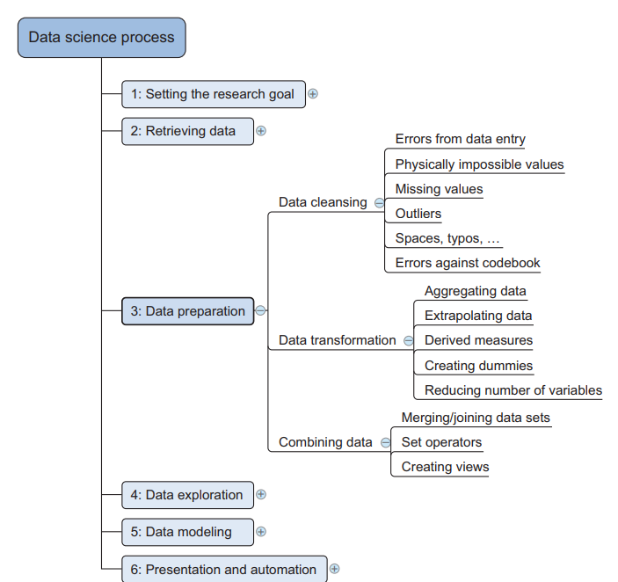

Slide 14
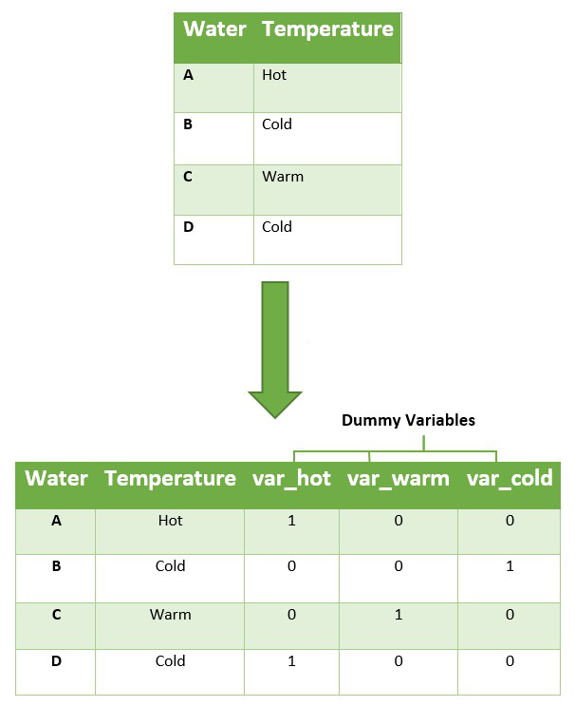
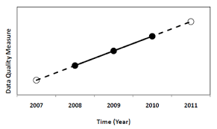

Slide 15
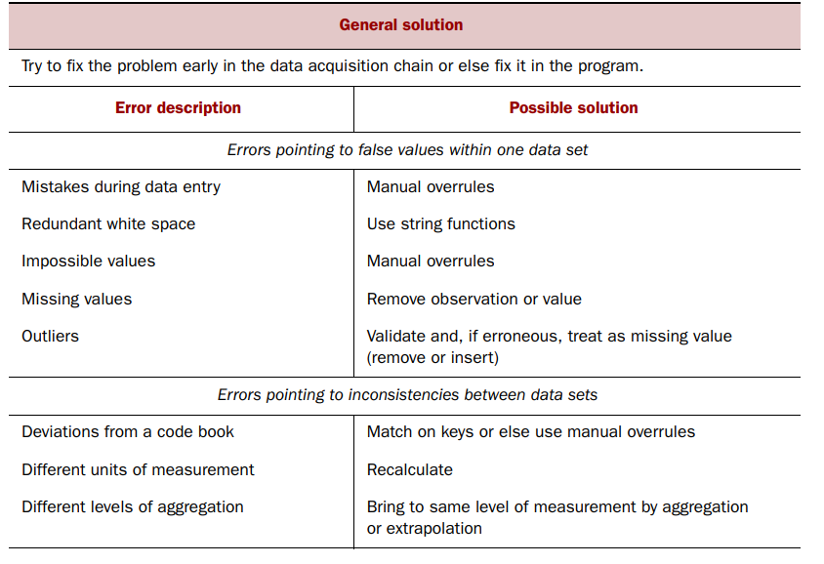

Slide 16
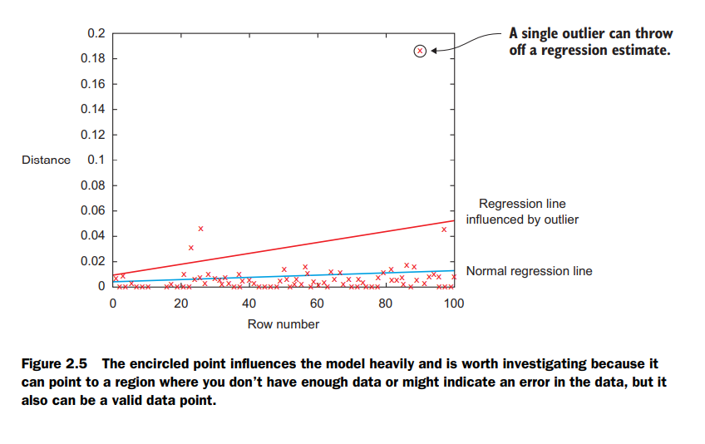

Slide 17
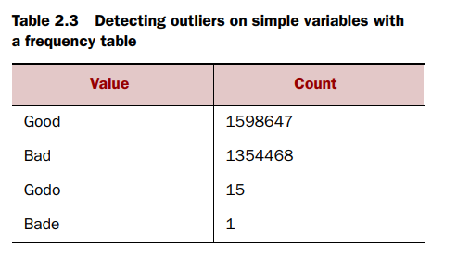
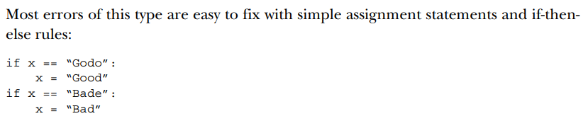

Slide 18
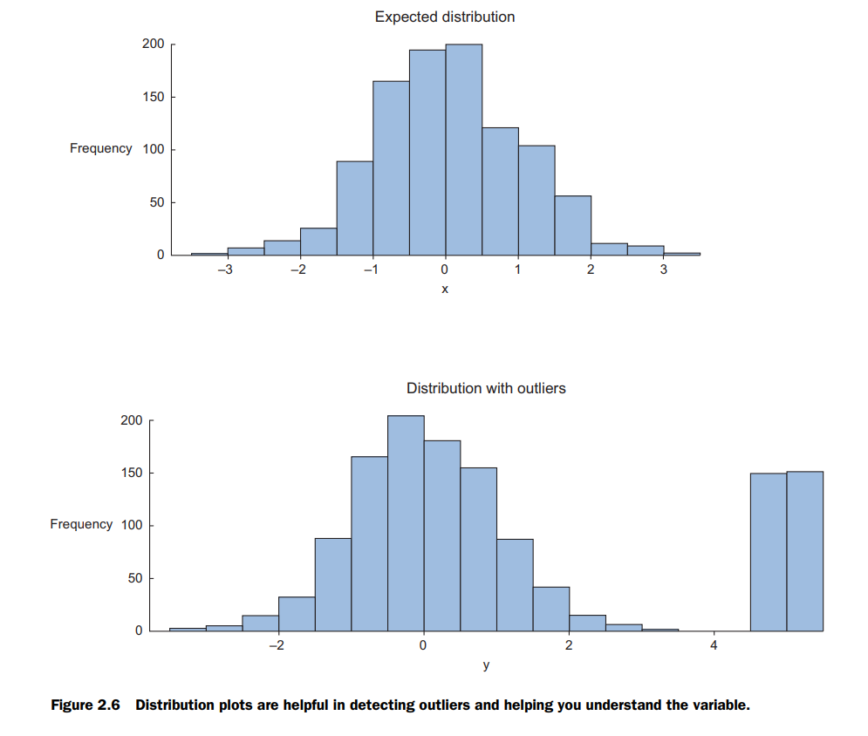

Slide 19
DEALING WITH MISSING VALUES
Missing values aren’t necessarily wrong, but you still need to handle them separately; certain modeling techniques can’t handle missing values. They might be an indicator that something went wrong in your data collection or that an error happened in the ETL process.

Slide 20
Step 4: Exploratory data analysis
During exploratory data analysis you take a deep dive into the data (see figure 2.14). Information becomes much easier to grasp when shown in a picture, therefore you mainly use graphical techniques to gain an understanding of your data and the interactions between variables. This phase is about exploring data, so keeping your mind open and your eyes peeled is essential during the exploratory data analysis phase. The goal isn’t to cleanse the data, but it’s common that you’ll still discover anomalies you missed before, forcing you to take a step back and fix them.

Slide 21
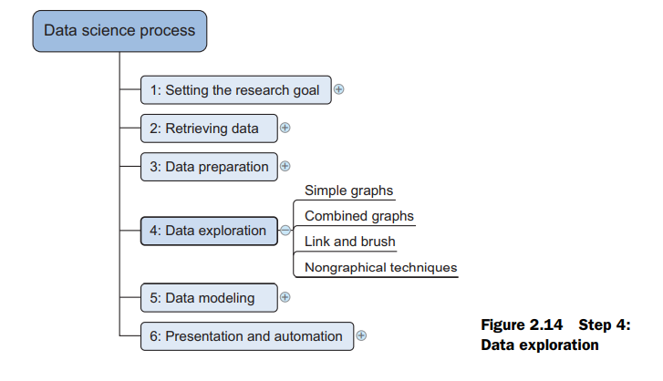

Slide 22
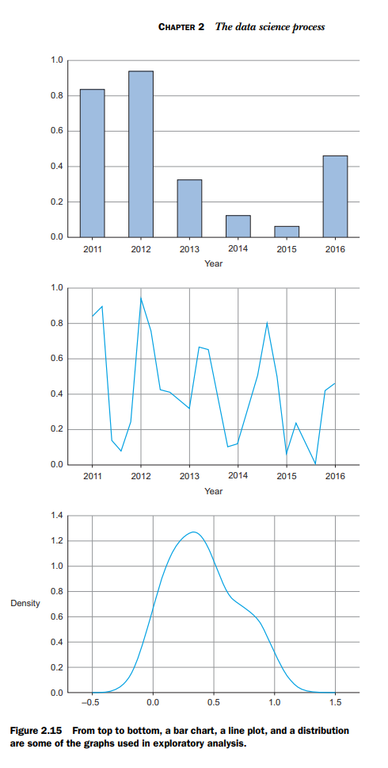
Mike Bostock has interactive examples
of almost any type of graph.
It’s worth spending time on
his website, though most
of his examples are more
useful for data presentation
than data exploration.

Slide 23
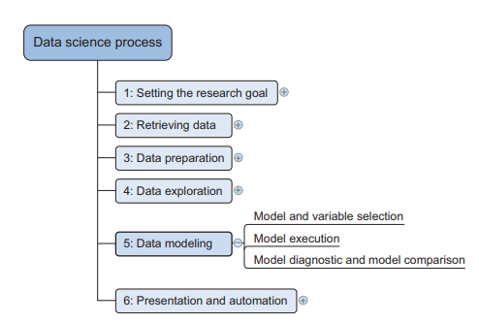
Step 5: Build the models
With clean data in place and a good understanding of the content, you’re ready to build models with the goal of making better predictions, classifying objects, or gaining an understanding of the system that you’re modeling. This phase is much more focused than the exploratory analysis step, because you know what you’re looking for and what you want the outcome to be. Figure 2.21 shows the components of model building

Slide 24
The techniques you’ll use now are borrowed from the field of machine learning, data mining, and/or statistics.
In this chapter we only explore the tip of the iceberg of existing techniques, while chapter 3 introduces them properly. It’s beyond the scope of this book to give you more than a conceptual introduction, but it’s enough to get you started; 20% of the techniques will help you in 80% of the cases because techniques overlap in what they try to accomplish. They often achieve their goals in similar but slightly different ways. Building a model is an iterative process.
The way you build your model depends on whether you go with classic statistics or the somewhat more recent machine learning school, and the type of technique you want to use. Either way, most models consist of the following main steps: 1 Selection of a modeling technique and variables to enter in the model 2 Execution of the model 3 Diagnosis and model comparison

Slide 25
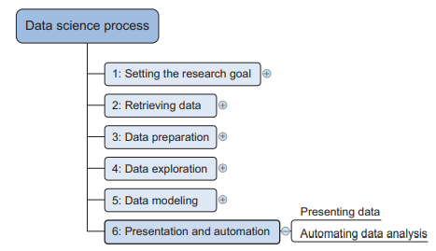
Step 6: Presenting findings and building applications on top of them
After you’ve successfully analyzed the data and built a well-performing model, you’re ready to present your findings to the world (figure 2.28). This is an exciting part; all your hours of hard work have paid off and you can explain what you found to the stakeholders.

